Slide 1
Introduction & Background Module 1
Operating Systems
Nadia Qureshi

Slide 2
Disclaimer
The material in the course slides has been taken from different sources. Most of the material has been taken from the book slides of Operating Systems Concepts by Silberschatz. There is editing at a lot of places and inclusion of new material from course instructor. However, course instructor does not exhibit or claim any copyright over these slides material

Slide 3
Chapter Outline
Introduction to operating system
Application software
System software
Machine language
Microprogramming
Physical devices
History of Operating Systems
Types of Operating Systems
Introduction to Unix, MS-DOS and Windows

Slide 4
About The Instructor

Slide 5
Academic and Professional Experience:
PhD Computing ( Riphah International University Islamabad) ( In progress)
MS Software Engineering ( International Islamic University Islamabad)
Industry Experience (Web Development) 3 years
University Teaching Experience: 11 Plus years
Riphah International University Islamabad (2012 – 2015)
NUML Islamabad (2016 – 2023)
Research Area and Interest: Software Engineering, Generative AI

Slide 6
Assessment Criteria (likely to change)
Course 80% | Lab 20%
Mid 25% | Lab Tasks 10 %
Final 40% | Project/PBL 10%
Quiz 7%
Assignment 5%
NetAcad 3%

Slide 7
Plagiarism Policy
What is Plagiarism?
Plagiarism is presenting someone else’s work or ideas as your own, with or without their consent, by incorporating it into your work without full acknowledgement. All published and unpublished material, whether in manuscript, printed or electronic form, is covered under this definition. Plagiarism may be intentional or reckless, or unintentional. Under the regulations for examinations, intentional or reckless plagiarism is a disciplinary offence
What happens if you are thought to have plagiarized?
The plagiarism in examinations and assessments is a serious matter. Cases will be investigated and penalties may range from deduction of marks to downgrading of your course Grade.

Slide 8
OS

Slide 9
Operating System Definition
Operating Systems (System Software)
OS is a control program which manages computer resources and allocate these resources among competing tasks
operating system (OS), program that manages a computer's resources, especially the allocation of those resources among other programs. Typical resources include the central processing unit (CPU), computer memory, file storage, input/output (I/O) devices, and network connections.
OS controls and coordinates use of hardware among applications for users
https://www.youtube.com/watch?v=gxhxcvBuanU
Notes:
operating system (OS), program that manages a computer's resources, especially the allocation of those resources among other programs. Typical resources include the central processing unit (CPU), computer memory, file storage, input/output (I/O) devices, and network connections.

Slide 10
Operating System Goals
Execute user programs and make solving user problems easier
Make the computer system convenient to use
Use the computer hardware in an efficient manner
OS is the interface between the hardware and software environment
OS is a program that acts as an intermediary between the user and computer hardware

Slide 11
Computer System Overview

Slide 12
Computer System Overview
From hardware and software point of view, a computer system can be divided into six parts
Application programs (Web browser, Media Player etc.)
Compilers, editors, interpreters
Operating system
Machine language
Microprogramming
Physical devices
Notes:
microprogramming, process of writing microcode for a microprocessor. Microcode is low-level code that defines how a microprocessor should function when it executes machine-language instructions.

Slide 13
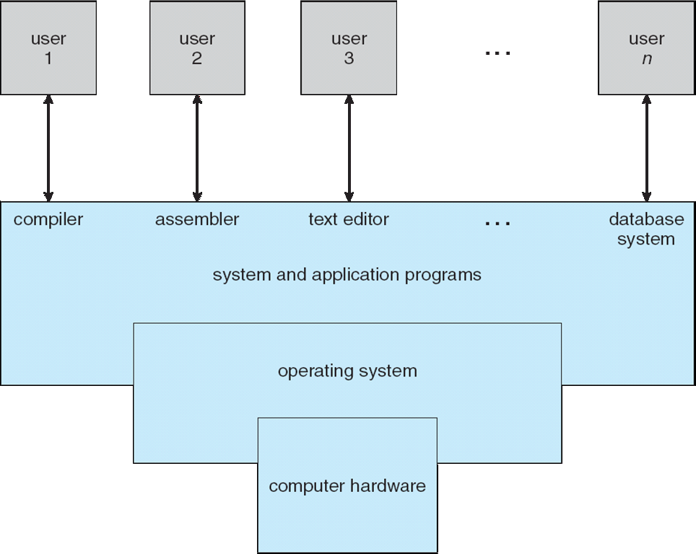
Computer System Overview

Slide 14
Computer System Overview
Application Programs
They are used to solve user’s problems
AP have specific processing’s capabilities required for user’s applications
Examples:
Word processor (Microsoft Word, Latex)
Spread sheet (Microsoft Excel)
Presentation tools (MS PowerPoint, KPresenter)
Inventory control system
Library management system
Notes:
What Does Application Program Mean?
An application program is a comprehensive, self-contained program that performs a particular function directly for the user. Among many others, application programs include:
Email
Web browsers
Games
Word processors
Enterprise software
Accounting software
Graphics software
Media players
Database management
Because every program has a particular application for the end user, the term "application" is used. For instance, a word processor can help the user create an article, whereas a game application can be used for entertainment.
An application program is also known as an application or application software.

Slide 15
Computer System Overview
System Programs
They are used to manage operations of computer and to control its resources
Oriented to the needs of hardware and facilitate the development and running of applications
Examples:
Compilers (C Language Compiler)-In computing, a compiler is a computer program that translates computer code written in one programming language (the source language) into another language .
Editors (DOS Editor) – used to edit the programs
Shell (C Shell)- provides a command-line user interface (UI) to interact with an operating system
Interpreter (VB Interpreter) - a computer program that is used to directly execute program instructions written using one of the many high-level programming languages

Slide 16
Computer System Overview
Operating Systems
OS is an integrated set of programs used to manage the computer resources and its overall operations
Provide a layer of services which manage the resources of the hardware and permit the user to drive the system
Provide special services in absence of hardware facility using special software routines

Slide 17
Computer System Overview
Operating System performs
Resource Management
CPU management
Memory management
File System management
I/O management
Resource Sharing
Among Users
Among CPUs
Interfacing between hardware and users

Slide 18
Computer System Overview
Machine Language
Machine language programs are written in binary language
Machine language has 50-300 instructions
Used for moving data around the machine
Only language understandable by hardware
Every programming language code has to be converted into machine language

Slide 19
Computer System Overview
Micro Programs
They are normally permanently located in chips to perform some basic tasks
Example is micro program located in ROM
An interpreter, fetching the machine language instruction such as ADD, JUMP, MOVE and carrying them out as a series of little steps
To carry out an ADD instruction following steps are performed
The micro-program determines where the number to be added are located
Fetch them
Add them
Store them in proper location

Slide 20
Computer System Overview
Physical Devices
These are basically hardware components used in a computer
At the lowest level they have to actually perform the user’s tasks
Example:
Processor
Motherboard
Memory
Keyboard
Mouse

Slide 21
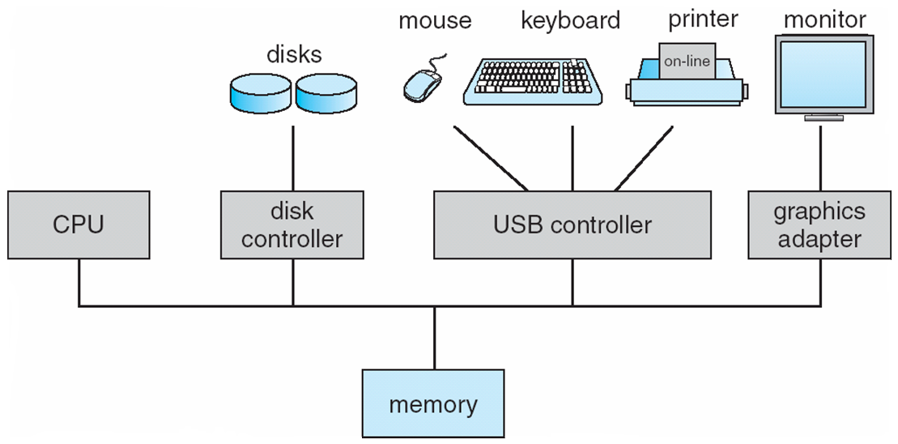
Computer System Organization
Computer-system operation
One or more CPUs, device controllers connect through common bus providing access to shared memory
Concurrent execution of CPUs and devices competing for memory cycles

